Slide 1
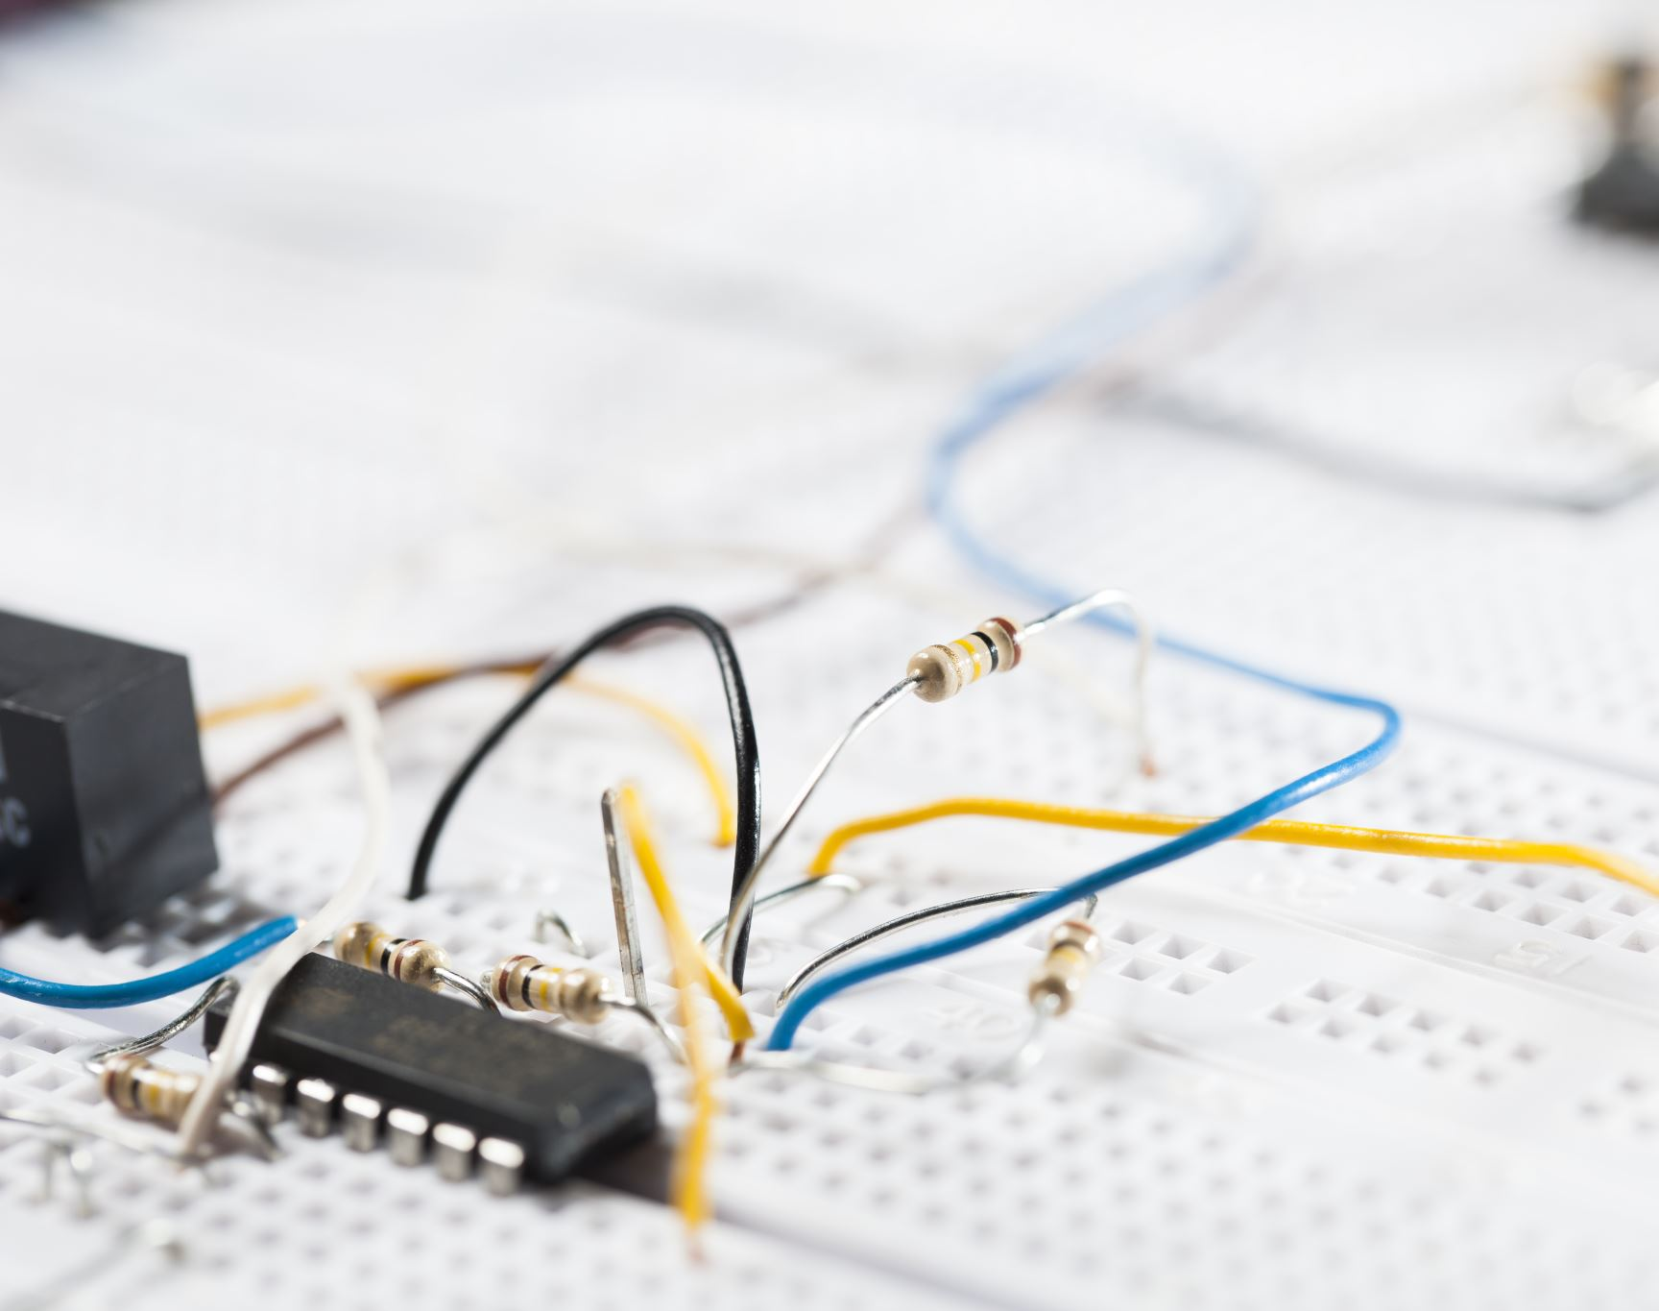
CW 1 Electronics Practice For Robotic Application

Slide 2
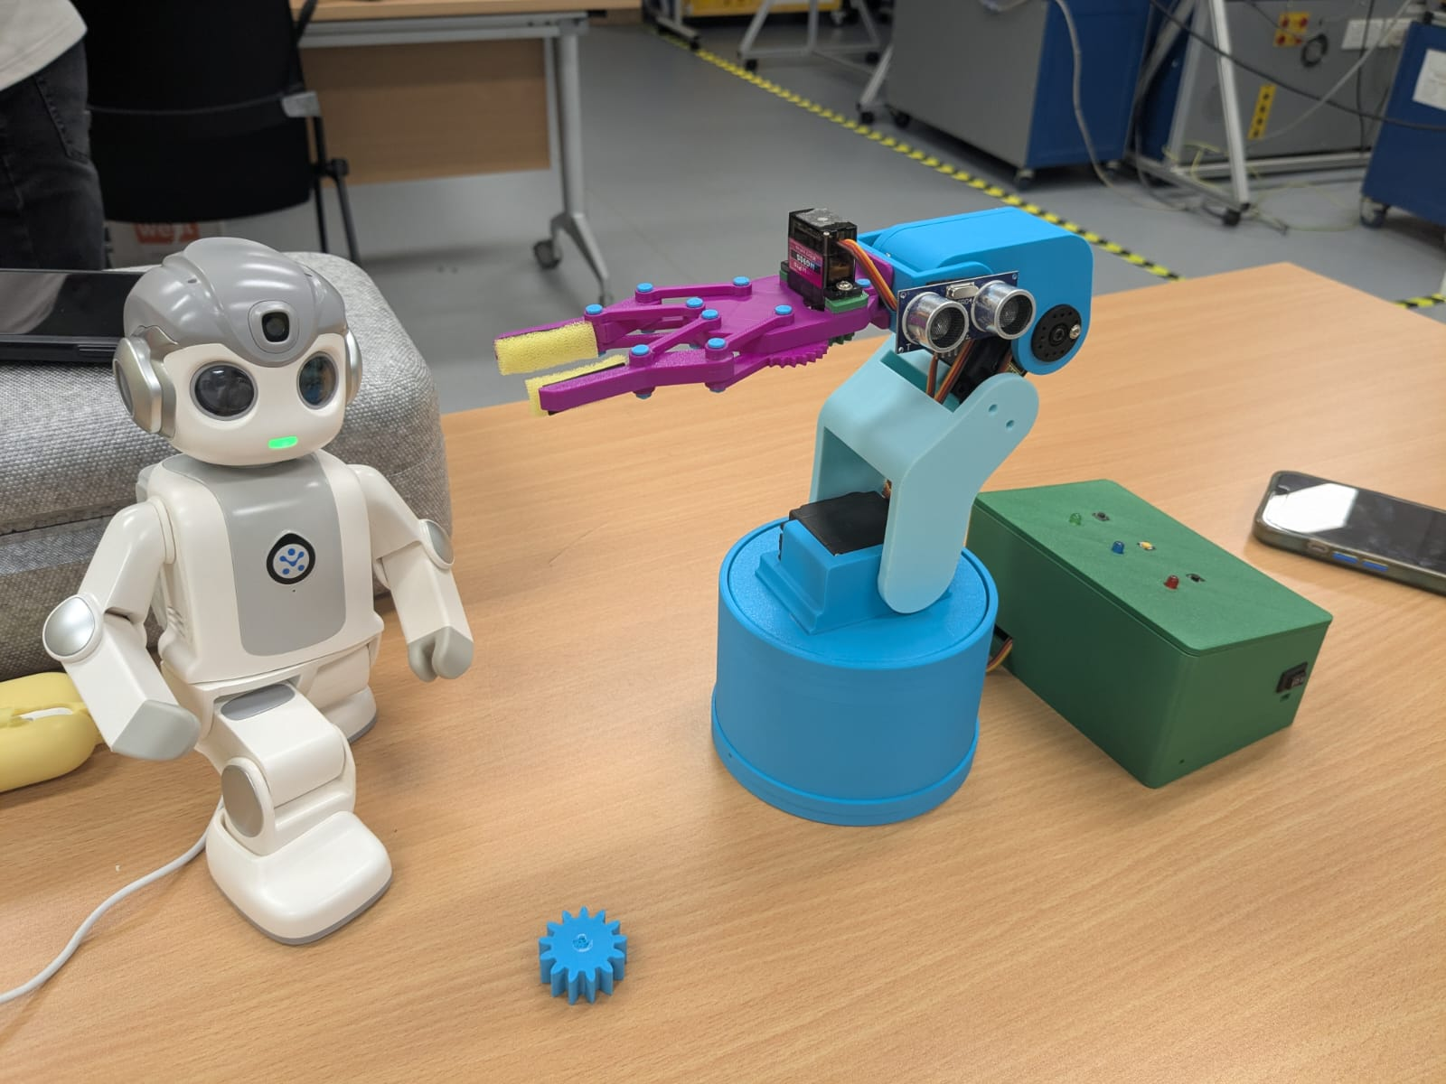
Introduction
This Arduino-based smart robotic arm integrates servo motors, sensors, and safety features for automated movement. It responds to IR sensors, ultrasonic detection, and user commands, with LEDs and a buzzer for real-time feedback. Key functions include object detection, obstacle avoidance, and an emergency stop, making it ideal for industrial, educational, and assistive applications.

Slide 3
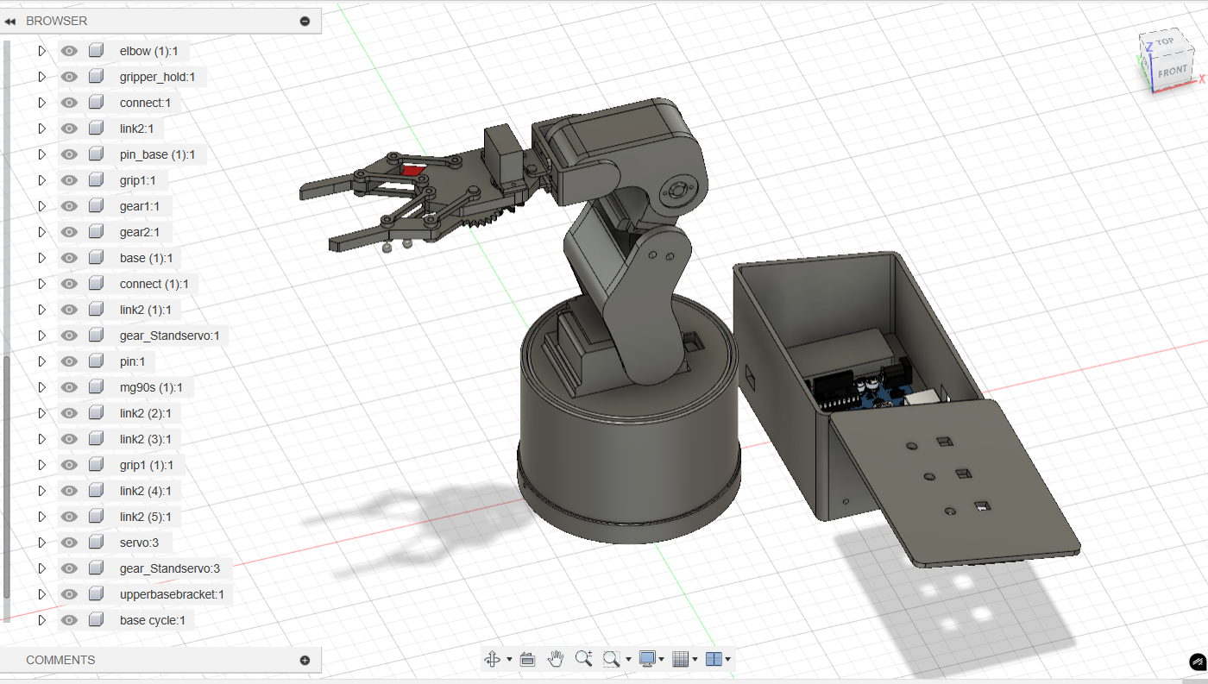
Getting same fully Functional Design
3D reversed drawing for servos and controller with specific dimension
That will get no error printed mechanism
Making sure with 3D simulation for joint and mechanism

Slide 4
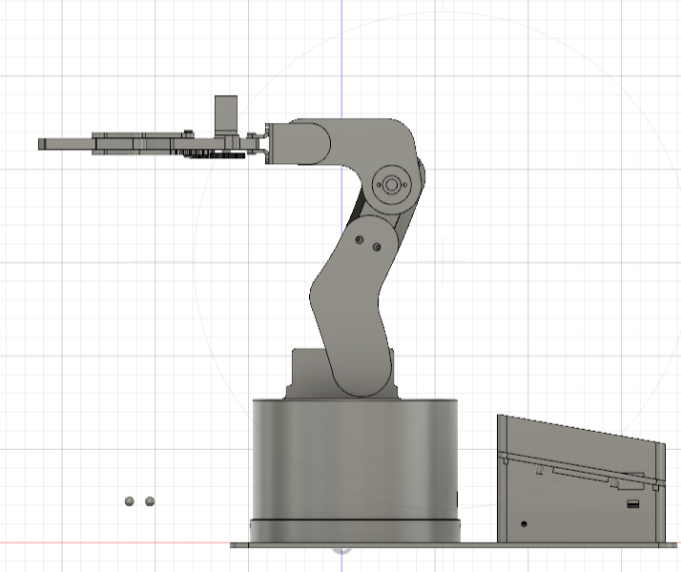
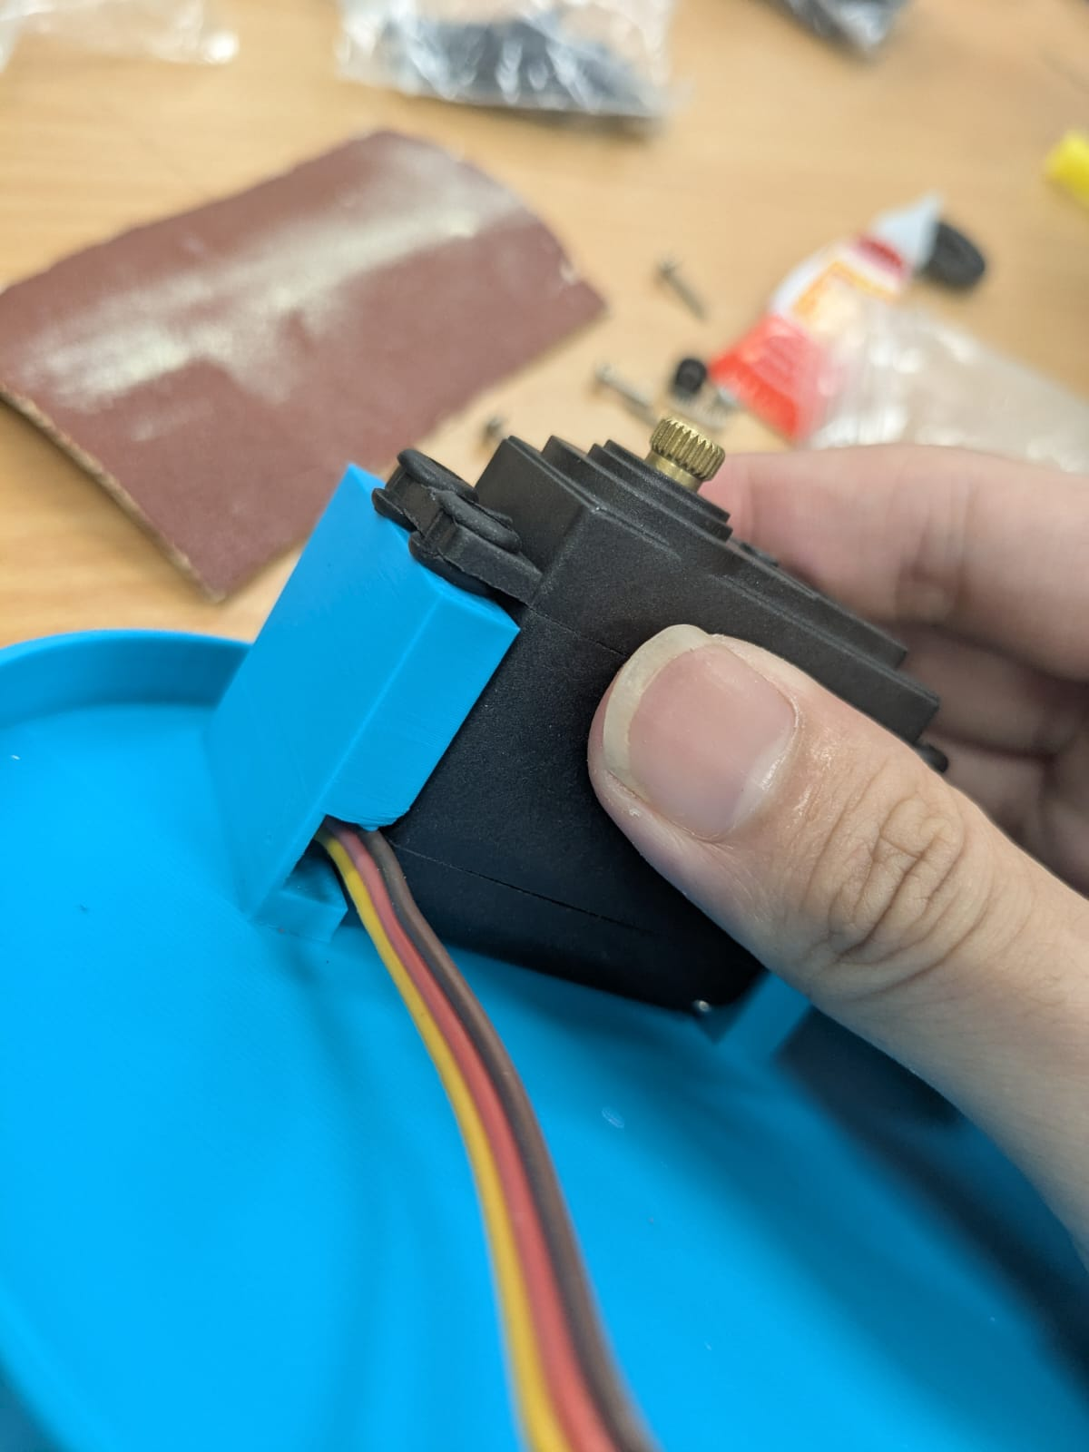
3D design
In my design, I used 3 Standard servos and 2 Micro servos (metal Gear).
Balance weight
Move smoothly
Calculated damping and vibration for motor and movement
Compact & Lightweight Design (used 3D printed bolts and nuts)
All parts are 100% fixed
Gripper weight
Standard servo weight
Carved arm

Slide 5
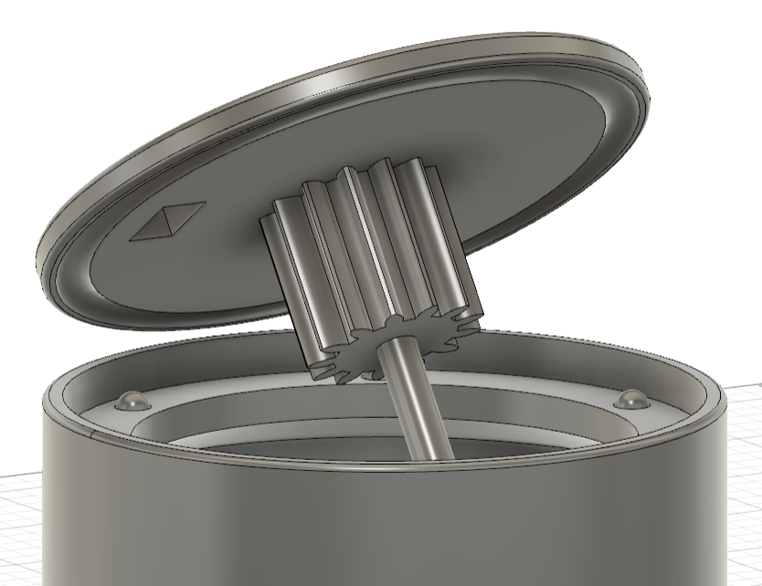
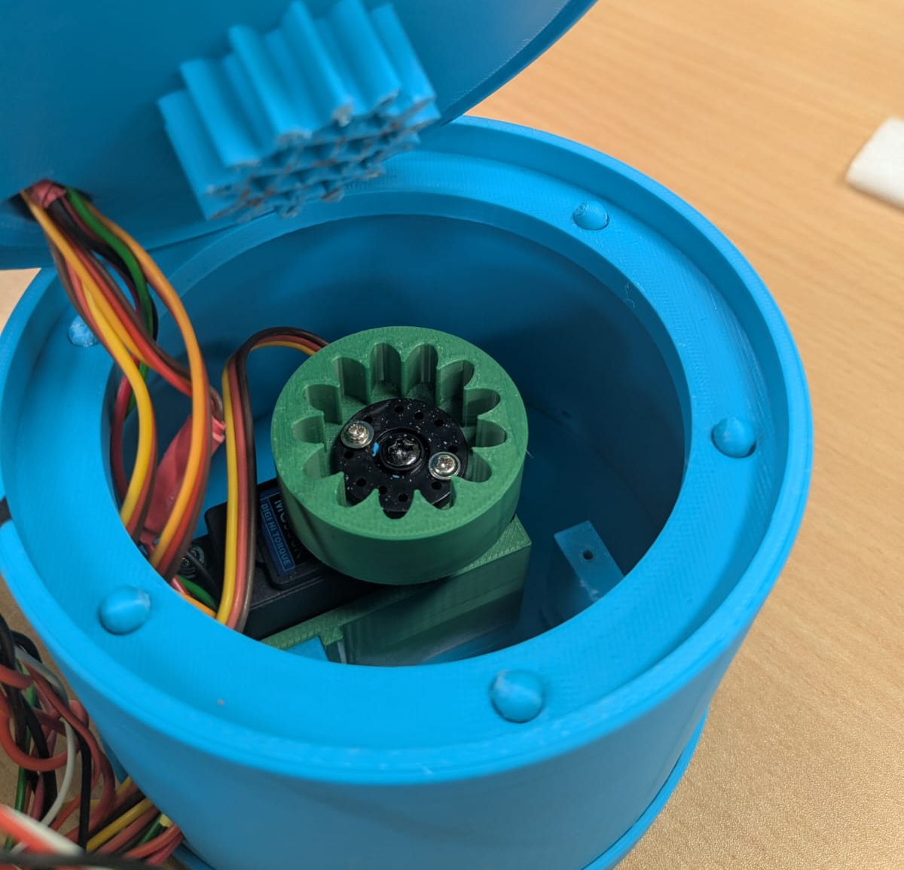
3D printed bearing
To get smoothed moving, need bearing.
Implemented my own design for 3D printed bearing
Using bearing and gearing is not to damage the servo motors and will smooth

Slide 6
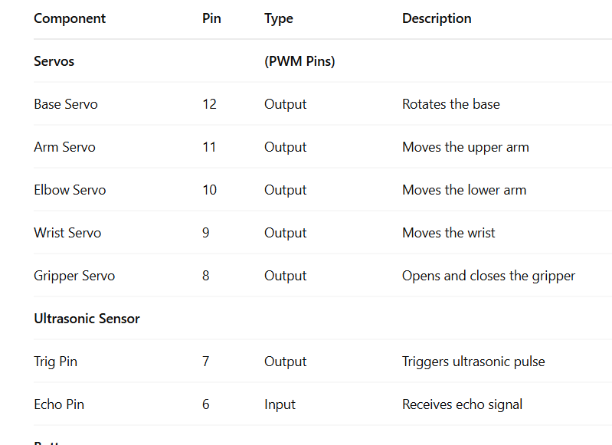
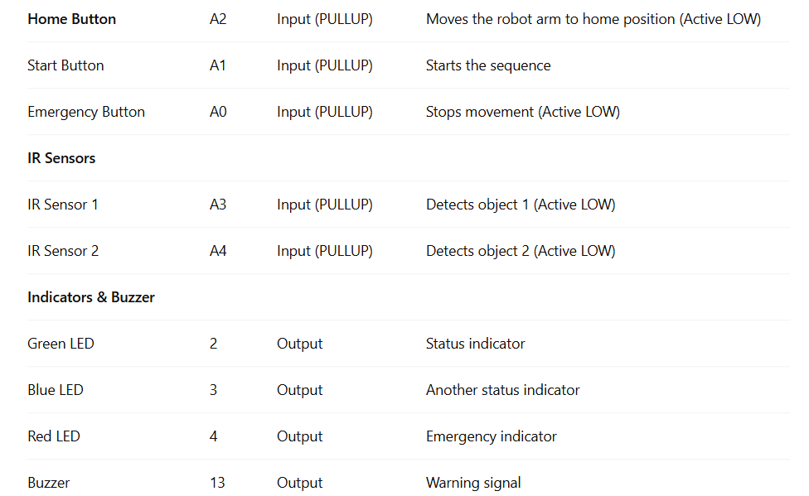
Pin Connection

Slide 7
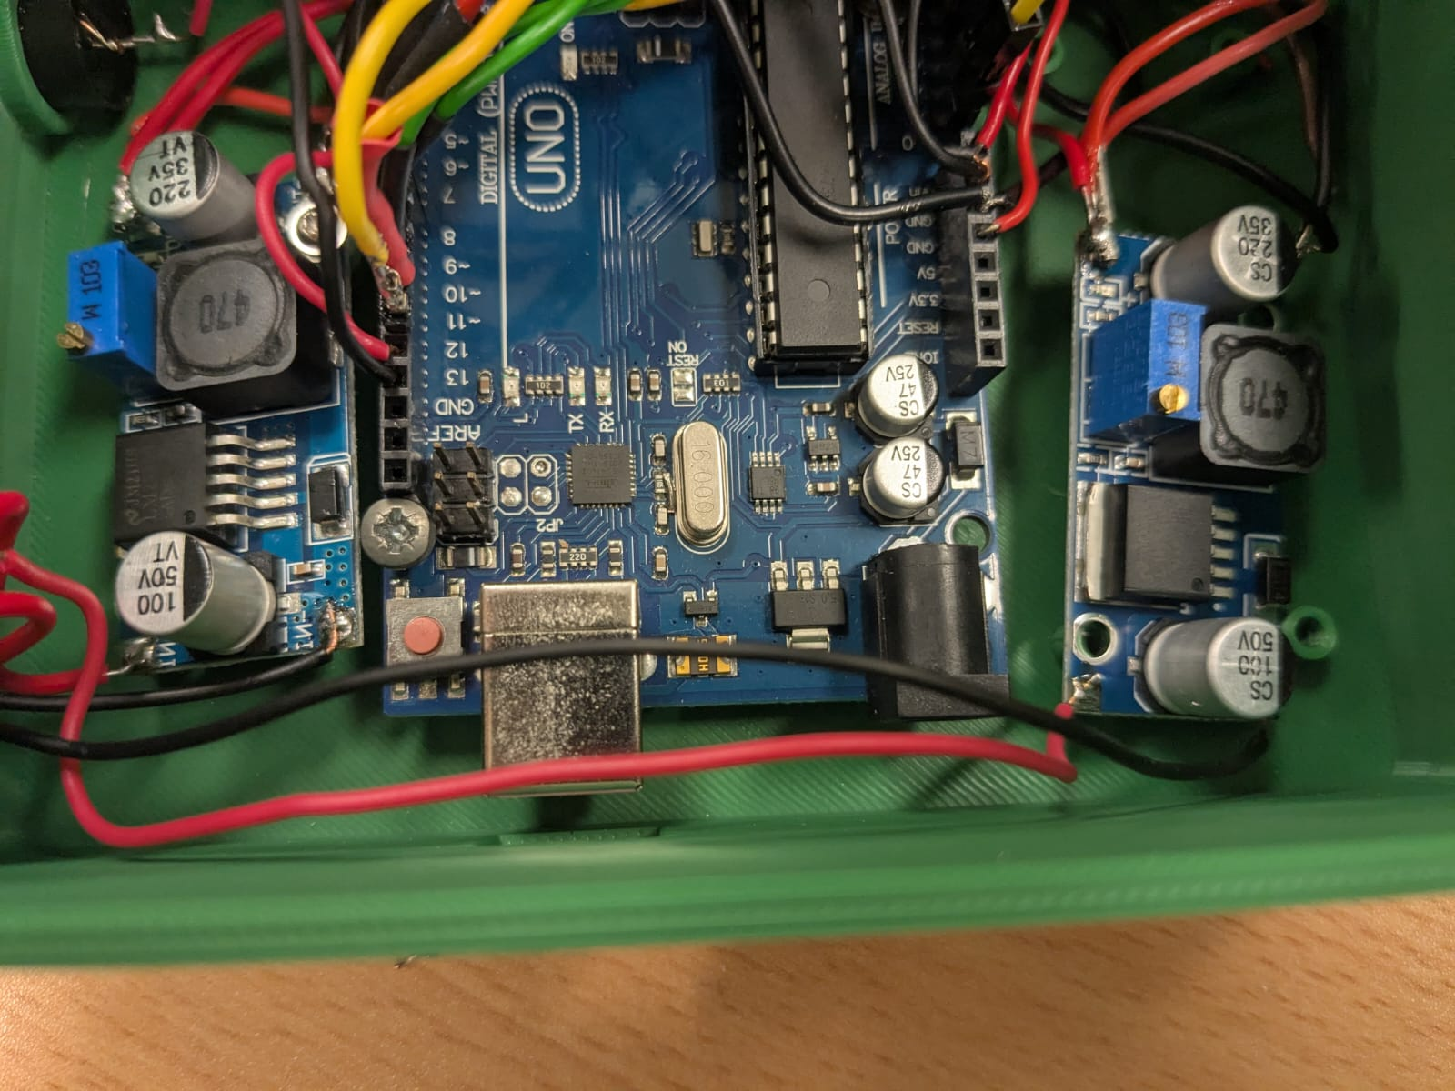
Why used LM2596
Current Demand: Each standard servo requires 2A. With 3 standard servos and 2 micro servos, the total current requirement exceeds what a single regulator can handle.
Power Distribution: Using two LM2596 regulators ensures an even distribution of power across servos, preventing overloading and potential damage.
Efficiency: Dual regulators improve efficiency by reducing the chance of overheating and voltage drops, ensuring stable operation.
Reliability: Separating the voltage and current load across two regulators minimizes the risk of instability or failure in the power supply system, keeping the robotic arm running smoothly.
Overload Prevention: This setup prevents a single regulator from being overloaded, enhancing the overall durability and longevity of the system.

Slide 8
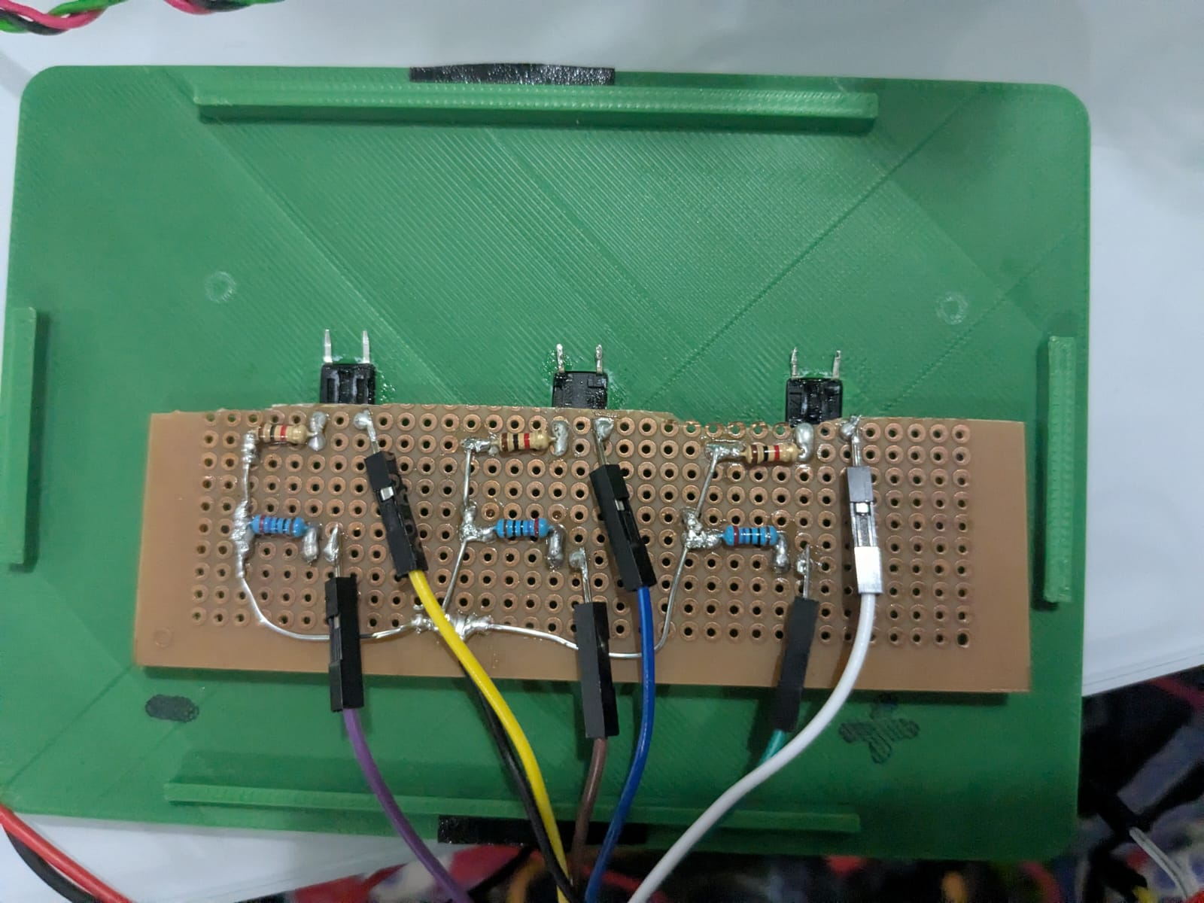
Circuit board for control box
Clear wiring and sure soldering
Declare the VCC and GND
Using standard wire color
Using suitable Ω resistors for leds and buttons

Slide 9
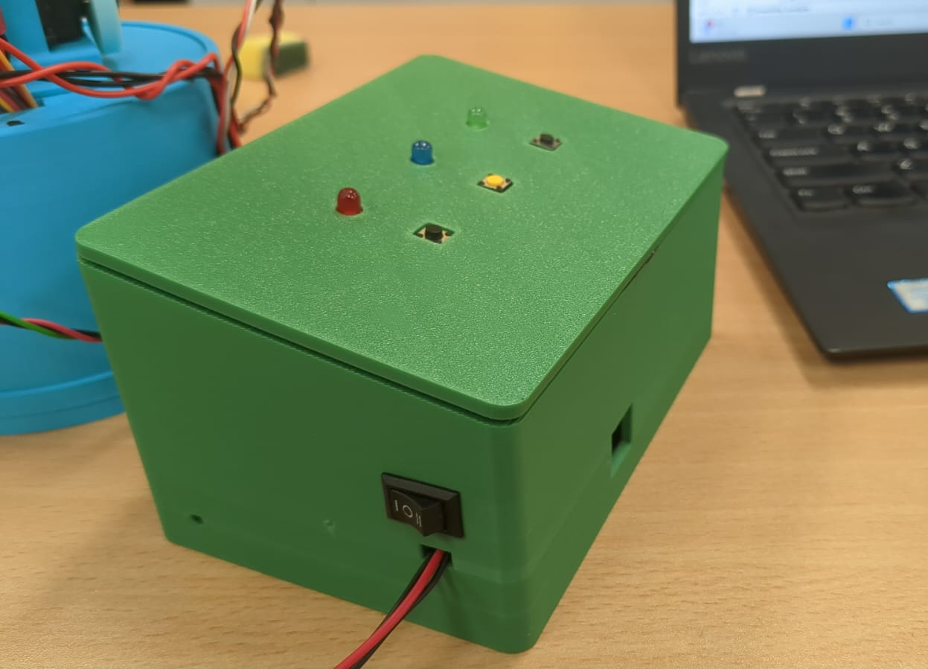
Clear design and Fully Functional
Using 3pin switch to off, AC mode, DC mode
Hole for buzzer not to vibrate and not to get noise for the control circuit
User interface is easy to use
Full function for robot arm

Slide 10
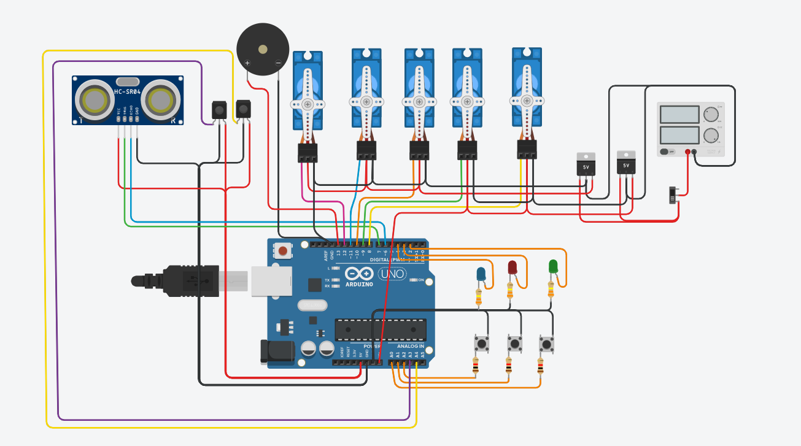
Wiring diagram and simulation
Clear wiring diagram
Using standard wire clear to see

Slide 11
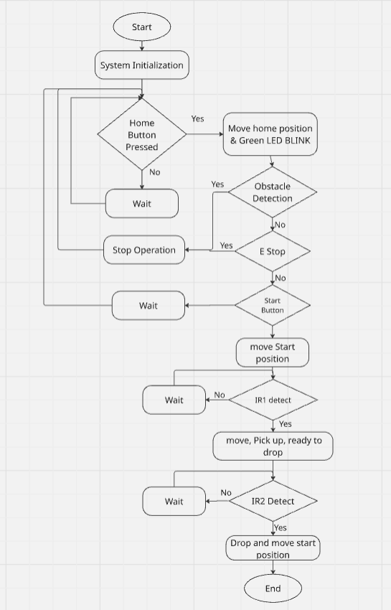
Flowchart for robot arm system

Slide 12
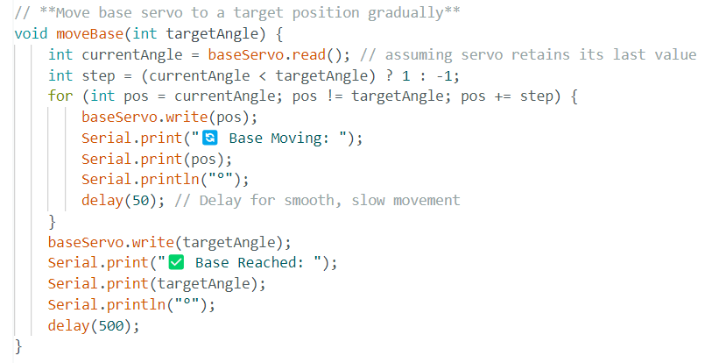
Algorithm for Smooth moving
Implemented the smooth algorithm instead of using servo driver board
Controlled with PMW with Arduino pin

Slide 13
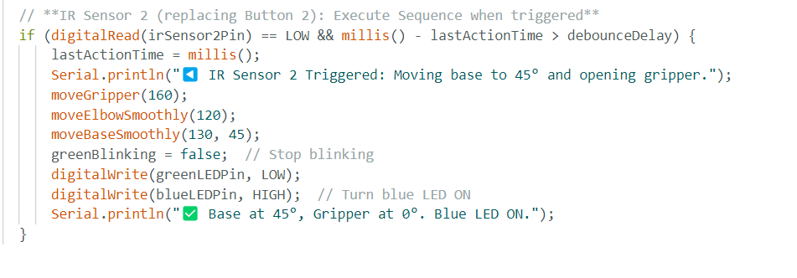
Sure to be detection & timestamp
To be sure to detection, I used this method and calculation
To make sure you don’t trigger the same action multiple times too fast
checks how long it's been since the last action happened
only continue if it's been more than the debounce delay (e.g., 200 ms).
update the timestamp so the next action won't happen until the delay has passed.

Slide 14
Reflection for Developing of Robotic Arm and Testing
1. Project Understanding & Goals
The objective of this project was to design and develop a robotic arm capable of picking up and placing objects at a desired location, ensuring smooth operation, obstacle detection, and system feedback. The implementation involved three Standard servo, two micro servo motors for movement, an ultrasonic sensor for obstacle detection, Led & buzzer for feedback, switches for the home position, start position and emergency state, and an Arduino Uno for control.

Slide 15
Development Process & Current Setup
The robotic arm was developed with full-functions, ensuring proper wiring and functionality. Key components include:
Servo Motors: Control the arm's movement, ranging from 45° to 135° for smooth operation.
Ultrasonic Sensor: Detects obstacles within 15 cm, triggering a warning LED and stopping motor power if needed.
Home Button: Sets the arm’s home position for consistent movement.
Start Button: Activates predefined movements in the arm.
IR Sensors: Replace traditional buttons for improved automation and remote control.
Emergency Button: Stops movement and activates the red LED and buzzer for immediate alerts.
Arduino Uno: Central controller processing sensor data and controlling servos.
Pull-Up Resistor Button: Currently used, with plans to upgrade to IR sensors.
3D Design: The arm's structure was designed and tested in 3D, optimizing component placement for stability and functionality.

Slide 16
3. Key Challenges & Solutions
Servo Power Supply
Challenge: Standard servos can draw up to 2A each, causing high power demand and risking overload.
Solution: I used two LM2596 voltage regulators to split the current load and provide stable 5V power to different groups of servos, ensuring reliable performance.
2. Button Debouncing and Input Accuracy
Challenge: Unreliable button presses led to unexpected behavior in the system.
Solution: I combined external and internal pull-up resistors to stabilize input signals, eliminating false triggers and ensuring consistent button responses.

Slide 17
3. IR Sensor Detection Reliability
Challenge: IR sensors triggered multiple times in rapid succession, causing false or repeated activations.
Solution: A debounce logic was added using a timing check (e.g., 200ms delay), allowing only one detection per interval. This improved accuracy and system stability.
4. Servo Coordination for Object Handling
Challenge: Coordinating five servos to perform complex tasks like picking, moving, and dropping objects was difficult.
Solution: I predefined servo angles for each stage of the action.
Example positions: Ready to Pick Up: base 45°, arm 90°, elbow 120°, wrist 90°, grip 160°.
Ready to Drop: base 130°, arm 100°, elbow 170°, wrist 95°, grip 60°These presets simplified motion control and improved repeatability.

Slide 18
5. Emergency Response Mechanism
Challenge: The system needed to stop instantly in emergencies to prevent damage.
Solution: An emergency stop button was added. Pressing it halts all movement, lights a red LED, and activates a buzzer to signal alert.
6. Physical Design and Stability
Challenge: Movement caused instability and vibration, especially with larger servos.
Solution: I designed a 3D-printed frame with balanced weight distribution to maintain structural stability and smooth operation.
7. Smooth Servo Movement
Challenge: Jittery or abrupt servo transitions could affect precision and stress the hardware.
Solution: I used gradual stepping in the code to move servos smoothly from one position to another, improving control and extending servo life.

Slide 19
4. Learnings & Improvements
Throughout this project, I gained valuable experience in both hardware and software integration. I learned how to manage power distribution for multiple servo motors, handle input noise using proper debouncing techniques, and improve sensor reliability through logic and timing control. Coordinating complex servo movements taught me the importance of planning, testing, and using predefined positions for repeatability. I also realized the significance of physical design in ensuring stability and reducing vibration during movement. Most importantly, I understood how emergency handling and safety mechanisms play a crucial role in real-world robotic systems.
Need for Automation: The current button-based activation worked, but an IR sensor upgrade would allow for better automation and responsiveness.

Slide 20
5. Future Enhancements
Wireless Control & Automation
Implement Bluetooth or Wi-Fi connectivity for remote operation and real-time monitoring.
Advanced Object Detection
Upgrade from an ultrasonic sensor to a camera-based system with AI for better accuracy in object recognition.
Improved IR Sensor Logic
Optimize detection algorithms to differentiate between objects more accurately and minimize false triggers.
More Durable 3D-Printed Design
Use stronger, lightweight materials like carbon fiber-reinforced filament to improve durability and load capacity.

Slide 21
Better Emergency Handling
Add a software-controlled safety mechanism that gradually stops the servos instead of an abrupt halt to prevent mechanical stress.
Adaptive Learning & AI Integration
Implement machine learning algorithms to adapt movements based on previous interactions for better efficiency and precision.
Humanoid Robot Development
Improve articulation and control to integrate the robotic arm into a humanoid robot, enabling tasks like object manipulation and interaction with humans.
Industrial Robotics Applications
Enhance precision, load capacity, and automation features to make the arm suitable for industrial tasks such as assembly line operations, pick-and-place automation, and quality control.

